Slide 1
Climate Change & Sustainable Turtle Conservation

Slide 2
Values of Forests
Ecotourism
Climate Change
Disaster Reduction
Poverty alleviation
CO2 Reduction
Biodiversity
Oxygen
Water
Food
Medicines
Industry
Recreation

Slide 3
Effects of Deforestation
Atmospheric
Hydrological
Ecological
Global climate change due largely to emissions of carbon dioxide in the atmosphere
Affect water cycle - Reduces soil cohesion, resulting in erosion, flooding and landslides
Loss of Biodiversity
Extinction of animal, insect, plants
Destroy medicinal conservation

Slide 4
Loss of vegetation, decreased habitat
Decrease in number of species
Influx of non-native species
Increased infestation
Change in food supply
Loss of human cultural diversity
Less water in waterways
Sediment at mouth of rivers
More flash floods
Water temperature near river bank rises
Flow of water changes
Aquatic habitat degraded
Turbidity increases
Less Co2 taken in
Rain off increases
Burned trees adds even more Co2, which causes more evaporation, which leads to more precipitation
More sunlight reaches surface
Less photosynthesis
Increased risk of fire
Soil depleted quicker
Loss of minerals
Decrease in leaf litter,
Top -soil carried away, less wood for fuel, construction etc
Increased erosion from wind and water
Hydrosphere
Atmosphere
Deforestation
Geosphere
Biosphere

Slide 5
Climate Change
Changes in many climatic factors
(e.g. temperature and rainfall)
around the world

Slide 6
Forest Ecosystem
. Carbon Sinks
Forests and other ecosystems with the ability to sequester carbon
. Carbon Sequestration
The process by which CO2 from the atmosphere is absorbed by plants through photosynthesis and stored as carbon in biomass and soils

Slide 7
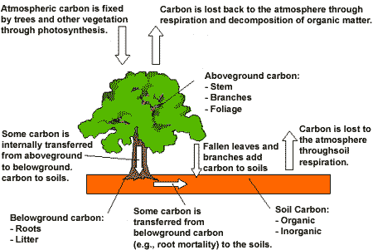

Slide 8
IPCC Assessment Reports
Vegetation and soils are estimated to trap 2.6 Gt of carbon annually
Tropical forests absorbs 1 Gt of carbon every year (40% of the total for land based absorption)
Carbon emissions resulting from land use change, mainly due to deforestation were in the vicinity of 1.6 Gt of carbon per year in the 1990s
At present, it is estimated that deforestation accounts for 20% of all the carbon released in the atmosphere

Slide 9
Initiatives
United Nations Framework Convention on Climate Change (UNFCCC – 1992)
Kyoto Protocol – 1997
Inter-governmental Panel on Climate Change (IPCC)

Slide 10
Effects of good forest management on wildlife
World Wildlife Fund
Convention of Biological Diversity
Identified more than 200 eco-regions as outstanding examples of the diversity of the world ecosystems
Estimates the accelerating rate of deforestation has contributed to reducing the forest species by more than 30 %
It is projected that between now and 2050 there will be a further 38% loss in abundance of forest flora and fauna

Slide 11
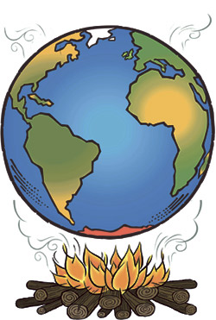
Effects of climate change on marine turtles
Possible effects of Global Warming
Changes in the incubation temperature, causing the ratio of male to female hatchlings to change
Affect hatch success
( % of eggs that hatch)
Loss of sandy beach habitat

Slide 12
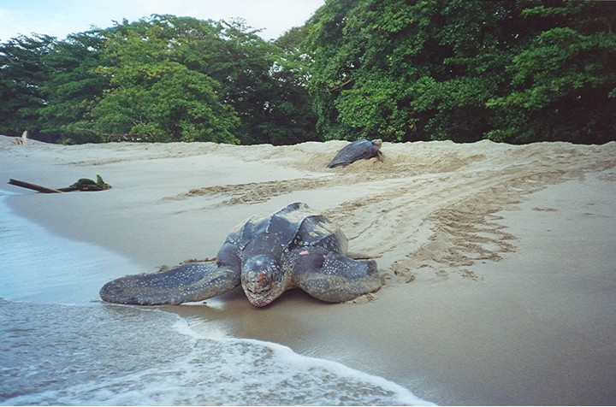
Dermochelys coriacea
Leatherback turtle

Slide 13
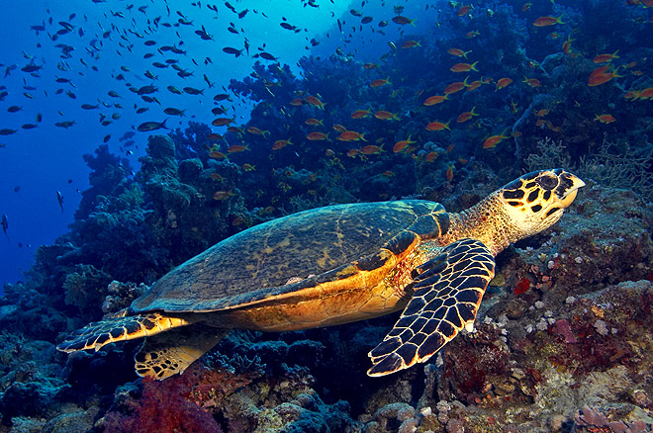
Eretmochelys imbricata
Hawksbill turtle

Slide 14
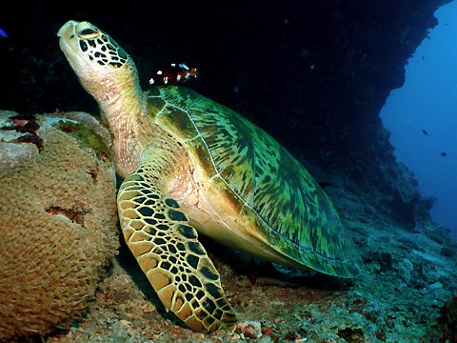
Chelonia mydas
Green turtle

Slide 15
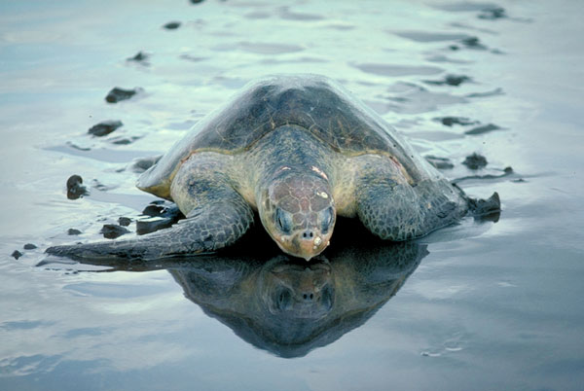
Lepidochelys olivacea
Olive Ridley Turtle

Slide 16
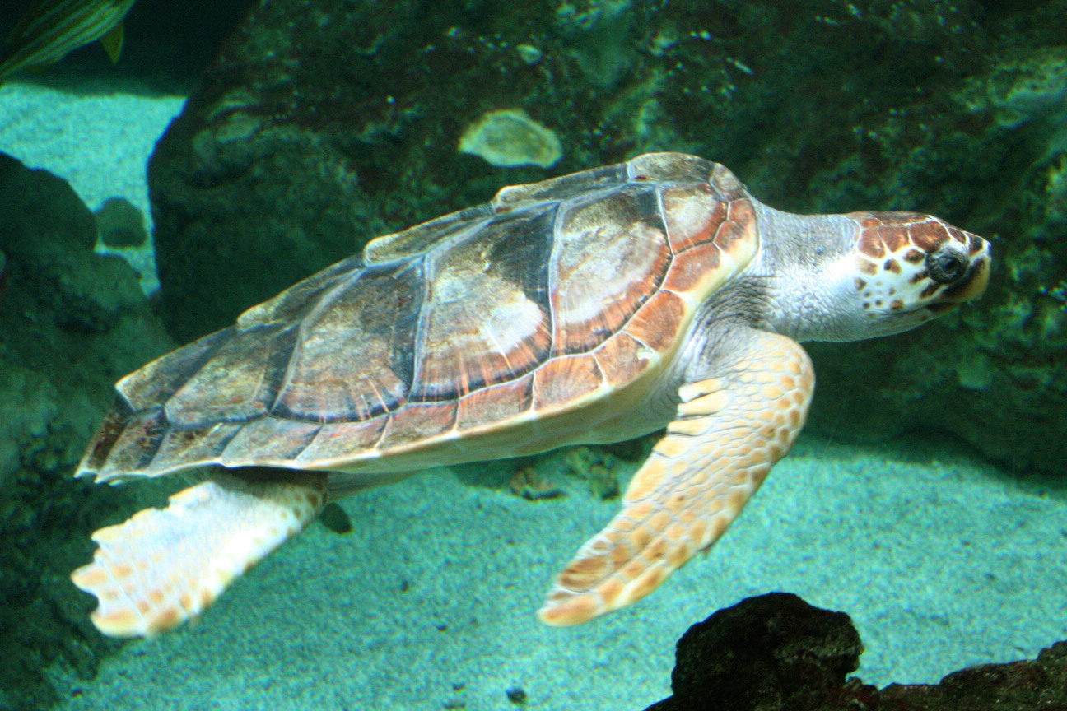
Caretta caretta
Loggerhead Turtle

Slide 17
Government & Communities
FORESTRY
Nariva Environmental Trust Manzanilla, Cocal, Kernahan Beaches
Blanchisseuse Community
Mariane Bay
Nature Seekers
Orosco, Rinchon Beaches
San Souci Wildlife Tours
Big Bay
PAWI Sports Culture & Eco Club
North Coast Beaches
Paria, Madamas, G/Tacaribe Beaches
GRNTGA
Grande Riviere Beach
Toco Foundation
No head, Mission, Salibay, Tompie, Patience
North Manzanilla
Village Council
North Manzanilla Beach
Fishing Pond Turtle Conservation Group
Fishing Pond Beach

Slide 18
Turtle nesting beaches
Grand Tacaribe
Grande Riviere
Paria Bay
Madamas
Sans Souci
Blanchisseuse
Mission
Toco
Matura
Fishing Pond
North Manzanilla
Manzanilla
Mayaro

Slide 19
Future Initiatives
Revised Forest Policy
Reflect the changing social, economic, environmental & legal circumstances impacting on the forest estate and wildlife in Trinidad & Tobago
New Protected Areas Policy
Guide the management of national parks and other outdoor recreation activities
Legislative Review
Government has mandated an increase in the fines and penalties in the 1958 Conservation of Wild Life Act
New Strategic Plan
New policies and legislation, that would provide a greater impetus for the management of the forests, wildlife, parks and wetlands

